Slide 1
ISTA 331
LAB 3
SPRING 2020

Slide 2
Important Pandas Methods
read_csv: uploads data in a csv file into a pandas data frame
Read the documentation on how to customize this
concat: concatenates pandas objects (Series, data frames)
Only works if they have an axis in common (the same index or column names)
The documentation is helpful for understanding how to concatenate pandas objects
column_stack: takes 1-D arrays and converts them to a 2-D array
Documentation

Slide 3
Important Pandas Methods Cont’d
add_constant: creates an array of ones
Documentation
This adds a constant term to the linear equation it is fitting
Necessary to get the intercept
The intercept is not included by default and the user has to add it
It is the difference between y = mx and y = mx + b
It tells the model to fit a value for b as well as coefficients for your predictors

Slide 4
Fitting a line and getting stats using OLS
Make an array of constants
Call OLS on statsmodels.api with the data frame and the array of constants as arguments
Fit the model and save it to a variable
Return the params, rsquared, mse_resid, fvalue, and the pvalue
How to do this
model = sm.OLS(df, constants)
results = model.fit()
return results.params, results.rsquared, results.mse_resid ** 0.5, results.fvalue, results.pvalue

Slide 5
Lambdas
Lambdas are one line, anonymous functions
They are used, for example, when you don’t want to use a function twice in a program
add = lambda x, y: x + y
print(add(3, 5))
#this outputs 8
a = [(1, 2), (4, 1), (9, 10), (13, -3)]
a.sort(key=lambda x: x[1])
print(a)
# Output: [(13, -3), (4, 1), (1, 2), (9, 10)]

Slide 6
Packing and Unpacking Arguments
Consider a situation where we have a function that receives four arguments. We want to make call to this function and we have a list of size 4 with us that has all arguments for the function. If we simply pass the list to the function, the call doesn’t work.
# A sample function that takes 4 arguments and prints them.
def fun(a, b, c, d):
print(a, b, c, d)
# Driver Code
my_list = [1, 2, 3, 4]
# This doesn't work
fun(my_list)
TypeError: fun() takes exactly 4 arguments (1 given)

Slide 7
Unpacking Arguments
Unpacking
We can use * to unpack the list so that all elements of it can be passed as different parameters.
# A sample function that takes 4 arguments and prints them
def fun(a, b, c, d):
print(a, b, c, d)
# Driver Code
my_list = [1, 2, 3, 4]
# Unpacking list into four arguments
fun(*my_list)

Slide 8
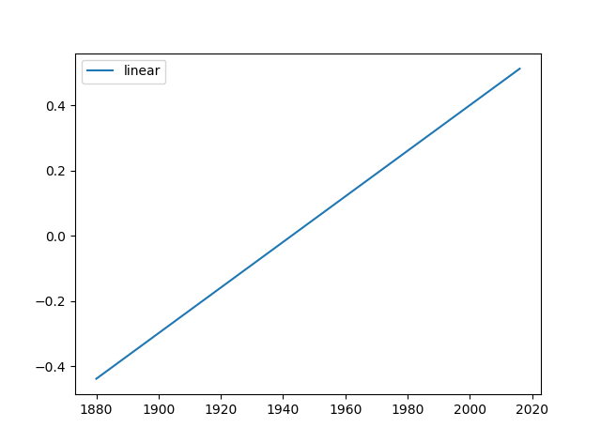
Assignment
Complete lab5.py in the lab folder
The plot created should look like the one below

